Slide 1

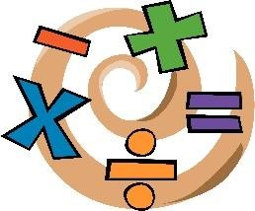


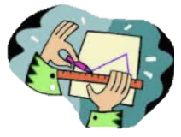

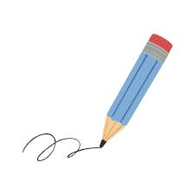

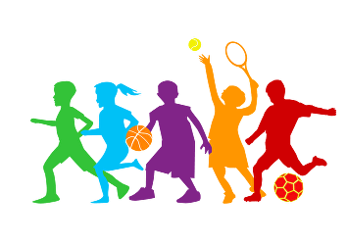
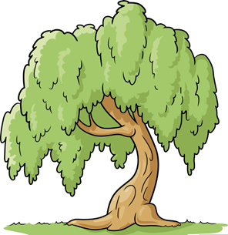



Curriculum Newsletter 2025-26
Class: Willow Term: Summer 2
Being a Mathematician
Being a Geographer
This term, children will develop their understanding of counting in 2s, 5s and 10s, and apply this to working with money. They will learn to recognise and use coins to solve simple problems. Children will also explore length, height, mass and volume through measuring and comparing, and begin to understand fractions, including halves and quarters.
This term, children will learn about rural and urban environments, locate London and Broadstone on a map, and compare key human and physical features.
Being a Reader
Children learn to read through the Little Wandle phonics programme, which is taught twice daily to build strong foundations in decoding and fluency. Alongside this, they take part in three focused reading sessions each week, where they practise decoding, develop expression (prosody), and build comprehension skills by answering questions about what they’ve read.
Being a Designer
Being a Scientist
This term, children will learn about structures, exploring how they are built and what makes them strong and stable. They will identify natural and man-made structures, investigate materials, and design and build their own models using simple joining techniques.
This term, children will learn about plants, identifying their parts and naming a variety of common flowers and trees. They will explore the differences between deciduous and evergreen trees and compare and group plants based on their features.
Being an Author
This term, children will develop their writing through poetry inspired by Julian is a Mermaid and narrative based on Lubna and Pebble. They will practise composing simple sentences using capital letters, spaces and full stops, adding descriptive noun phrases, sequencing ideas, rereading their work to check it makes sense, and reading their writing aloud clearly to others.
Being a Citizen
Being an Athlete
This term, children will learn how to stay safe in different situations, at home and out and about. They will learn about trusted adults, understanding strangers, keeping personal information private, and who to go to for help.
Children will develop movement skills and aiming accuracy through athletics and target games.
Being a Philosopher
Being a Musician
Being a Computer Scientist
This term, children will learn about forgiveness and explore the festivals of Rosh Hashanah and Yom Kippur. They will learn why these are important to Jewish people and reflect on how people can learn from past actions and make positive choices.
This term, children will explore Carnival of the Animals, learning how instruments, rhythm and musical elements are used to represent different animals while building key musical vocabulary.
This term, children will learn how to label, sort and group objects in different ways. They will explore object properties, compare groups, and record what they find, beginning to understand how grouping helps us organise information, including on computers.
Notes:
1

