Slide 1


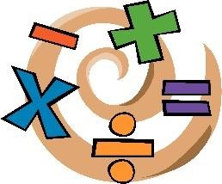
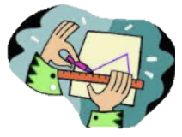
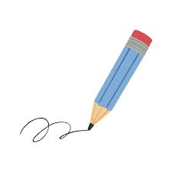



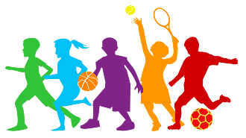
Curriculum Newsletter 2025-26
Class: Year 5 Term: Summer 2
Being a Reader
Being a Mathematician
Being a Geographer
In reading, Year 5 pupils explore the poetry book Overheard in a Tower Block by Joseph Coelho. They develop skills such as inference, performance and discussing themes in poems. Children learn to explore language, rhythm and imagery, helping them understand meaning and express their ideas clearly about poetry.
In maths, Year 5 pupils learn about factors, multiples and prime numbers, helping them understand how numbers are connected. They also develop their knowledge of fractions, including comparing, adding and finding equivalent fractions. Children build confidence using reasoning and problem-solving to explain their thinking clearly.
In geography, Year 5 pupils learn about climate change and carbon footprints. They explore how human actions affect the environment and work together on projects to reduce emissions. Children also use maps and data to present their findings.
Being an Author
Being a Scientist
Being a Designer
In English, Year 5 pupils explore the text Curiosity and learn to write explanation texts. They use skills such as modal verbs, adverbs and parenthesis to add detail and show possibility. By the end, children plan, write and edit their own explanation about a Mars rover, using clear structure and organisation.
In science, Year 5 pupils learn about the human life cycle, from birth to old age. They explore how the body grows and changes, including puberty and development. Children also learn about reproduction, gestation and how to stay healthy at each stage of life.
In DT, pupils design and make a stuffed toy using textiles. They practise measuring, cutting, stitching and decorating fabric. By the end, they create a finished product and evaluate their design.
Being a Citizen
Being a Computer Scientist
Being an Athlete
In PSHE, pupils learn how everyday substances like medicines, caffeine and alcohol can affect health. They understand how to make safe choices and why some substances are harmful. Children also learn how to ask for help and take responsibility for their wellbeing.
In computing, Year 5 pupils learn to create vector drawings using shapes and lines. They edit individual objects, using tools to layer, group and duplicate them. This helps them design clear and detailed digital images.
In PE, Year 5 pupils develop skills in cricket and tennis. They practise batting, throwing, serving and rallying, while improving coordination and control. Children also build teamwork, confidence and understanding of rules.
Notes:
1

