Slide 1

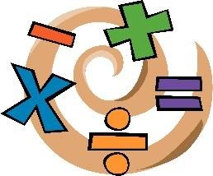




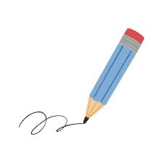






Curriculum Newsletter 2025-26
Class: Sycamore Term: Summer 2
Being a Mathematician
Being a Geographer
This half term, we will continue to practice what we have learnt over the year using all four operations, fractions, decimals and percentages. Also, we will learn about ratios, how to identify a pattern, as well as basic algebra of following a formula and calculating inputs and outputs.
This half term in Geography, we will develop our knowledge of Africa and Asia. This includes being able to use maps and atlases to locate countries in these continents. We will also consider the key physical and human features of these areas.
Being a Reader
Through the book ‘Incredible Journeys’ by Levison Wood, we will discover exciting stories of adventures and explorers. The children will learn how to summarise and sequence short stories and retrieve key information.
Being a Scientist
Being an Artist
In this unit we will learn about light and electricity. This will build on children’s understanding from previous years and will cover the following: that light travels in straight lines; how light reflects off objects; the shape of shadows; how to use symbols in circuits; how voltage affects a bulb; and how to change voltage in a circuit.
In Art, we will study the work of Yayoi Kusama and her work using Poka-dots. We will learn how she is created a range of her artwork before creating our own inspired by her.
Being an Author
This half term, we will be using two short videos as inspiration for our writing – Alma and Rock, Paper, Scissors. Both of the animated films will help the children to describe narratives, including the atmosphere and consider their choice of language carefully.
Being a Citizen
Being an Athlete
In P.S.H.E will consider the following question ‘How can we keep healthy as we grow?’ We will be focusing on how we can be resilient; how we can deal with peer pressure; and how we can resolve conflict.
Forest School - Monday
Thursday – rounders
Please come into school in your P.E kit on a Thursday and forest school clothes on a Monday.
Being a Philosopher
Being a Linguist
Being a Musician
Being a Computer Scientist
In RE, we will be studying Islam – including knowing what Muslims believe about life after death, known as Akira.
Le Weekend – the children will develop their vocabulary to read, write and speak about hobbies and interests they have. They will be able to build on their knowledge of telling the time in French.
In Music this half term, we will be learning and practicing the songs for our class performance. More details to follow….
Our unit this half term is based on variables and algorithms. We will explore how to create our own game using Scratch. The children will learn how to use a range of variables in their code to include scoring in their game.
Notes:
1

