Slide 1

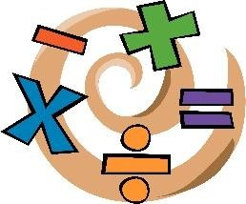






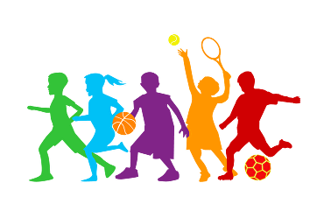



Curriculum Newsletter 2025-26
Class: Year 4 Term: Summer 2
Being a Mathematician
Being a Geographer
In Maths, we are beginning a unit on money, time and division, which will take us up to half term. We will start by learning how to recognise and use different amounts of money, including adding and subtracting amounts and giving change. The children will then develop their understanding of time, learning how to read clocks, convert between units and solve problems involving durations. Alongside this, we will explore division, focusing on how to divide numbers and interpret remainders in different contexts, while continuing to practise key multiplication skills.
In Geography, our unit is called Enough for Everyone, where children will explore how the Earth’s resources are used and shared. They will learn about settlements, energy sources and how food is produced and transported, as well as the impact of climate change. Pupils will also consider how people can live more sustainably and make choices to help protect the planet.
Being a Reader
This term, Year 4 will be exploring The Lion, the Witch and the Wardrobe by C.S. Lewis, using the story to develop key reading comprehension skills such as retrieval, inference and summarising. Children will delve into the magical world of Narnia, learning to gather important details from the text, make thoughtful inferences about characters’ feelings and motives, and summarise key events in the story.
Being a Designer
Being a Scientist
In Design and Technology, our unit is called Electrical Systems, where children will learn about how battery-powered products work. They will explore simple circuits, different types of switches and design and make their own torch to meet a design brief.
In Science, Year 4 will be learning about animals, including humans, with a focus on the digestive system and food chains. Children will explore how the body breaks down food, learn about the different parts and functions of the digestive system, and understand how nutrients are absorbed to keep us healthy, as well as how energy moves through food chains.
Being an Author
This term, Year 4 will be using The Lion, the Witch and the Wardrobe by C.S. Lewis in their writing lessons to explore how authors create vivid settings and detailed descriptions. Children will study how the magical world of Narnia is brought to life through rich language and imaginative detail, using this as inspiration to write their own narratives. They will focus on developing descriptive techniques to create atmosphere, build characters and engage the reader. Later in the term, pupils will apply their storytelling skills to write a narrative based on the life of Tutankhamun, using historical knowledge to support their ideas. They will then conclude their work with a diary entry written in role, allowing them to express thoughts and feelings from a character’s perspective.
Being a Citizen
Being an Athlete
In PSHE, our unit focuses on Health and Wellbeing, where children will learn about how their bodies change as they grow. They will explore puberty, including physical and emotional changes, the importance of personal hygiene, and how to seek advice and support when needed.
This half‑term in PE, Year 4 are swimming (group 2) and we will be doing Athletics during our Thursday sessions (once forest school finishes), this will be a mixture of track and field exercise.
Being a Philosopher
Being a Musician
Being a Computer Scientist
This term, Year 4 will be learning about Judaism, focusing on the significance of Passover and the importance of following rules within the Jewish faith. Children will explore how special meals, such as the Seder, are used to celebrate important events, and learn about key beliefs including Kosher food laws and why Jews choose to follow God’s teachings. They will also reflect on the importance of respect, considering how rules help people live together in a fair and thoughtful way.
Children will listen to a range of pieces and learn to identify key features of music, including pitch and different instruments. They will compose and perform their own melodies using the pentatonic scale, working both independently and collaboratively to create and share their ideas.
In Computing, Year 4 will be developing their understanding of programming and digital media. Children will learn how to create and edit audio and images, as well as designing programs using repetition in shapes and games. They will also explore how the internet works and how to stay safe online while using technology.
Notes:
1

